Slide 1
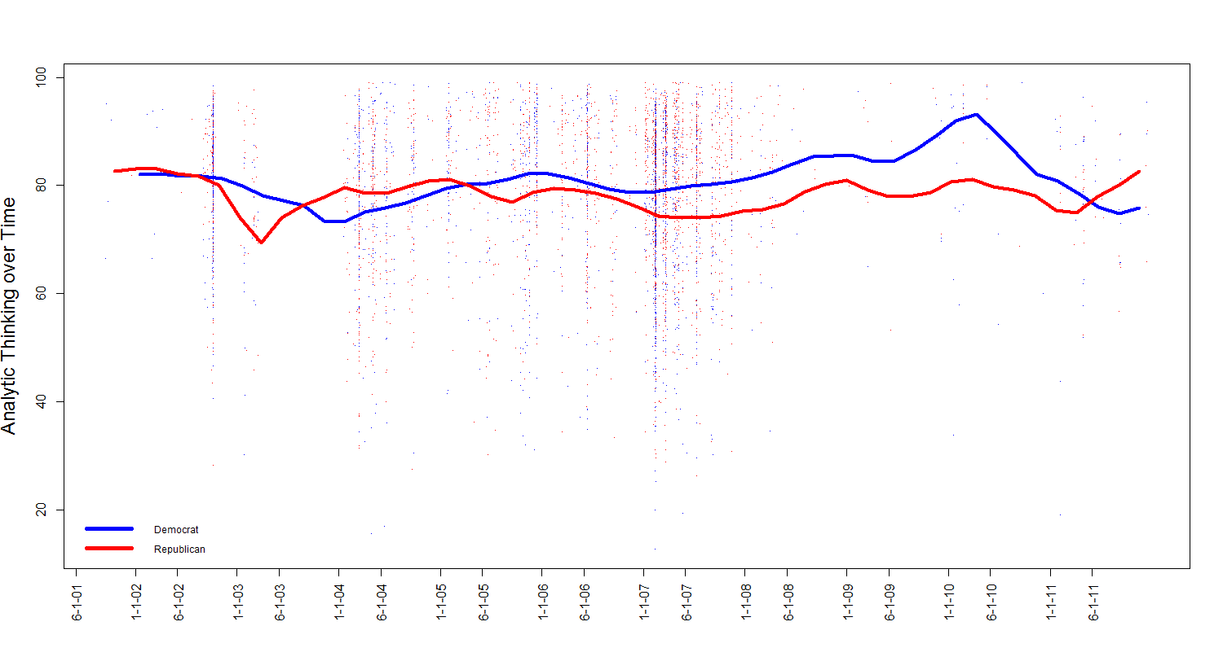
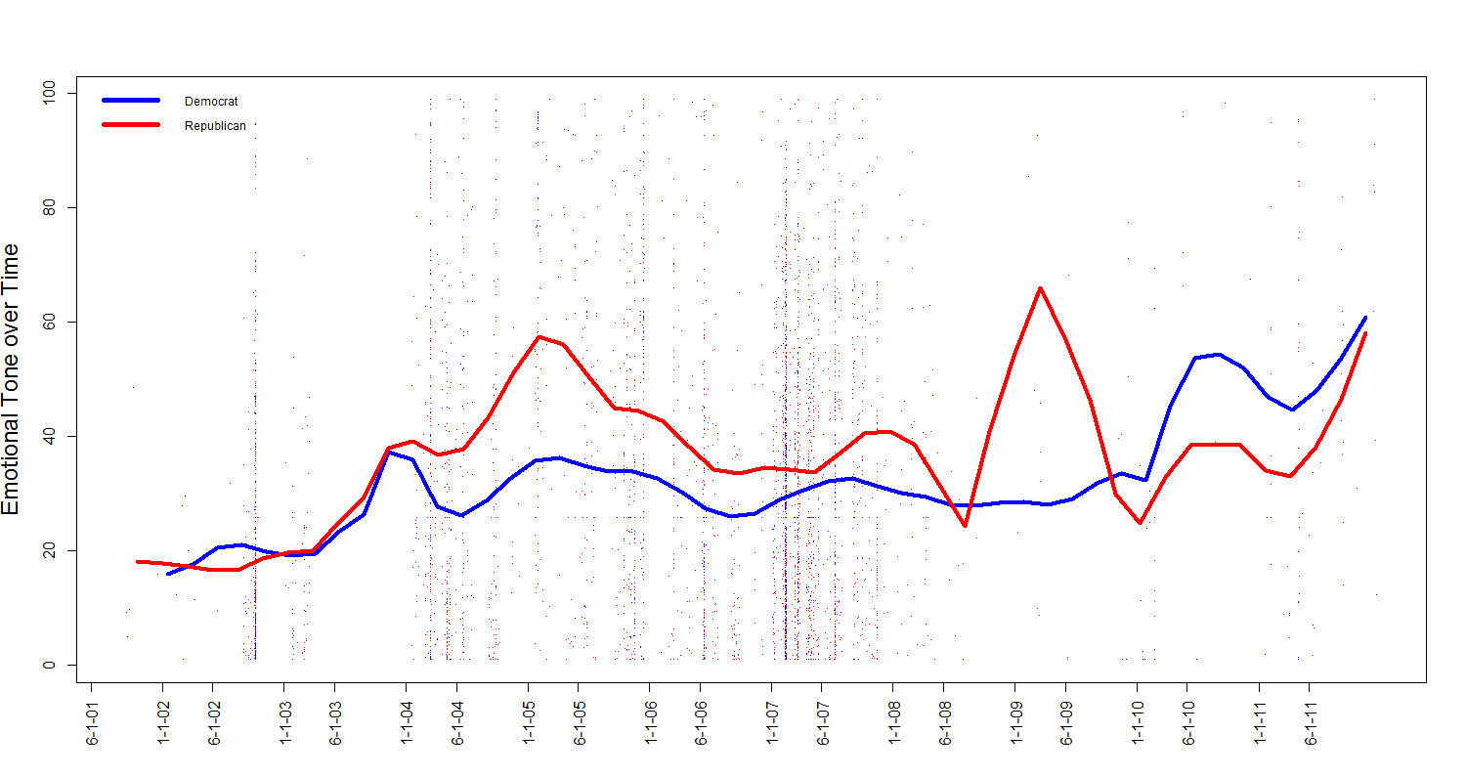
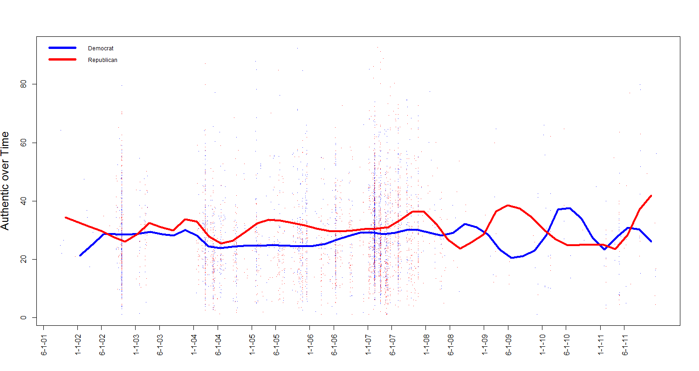
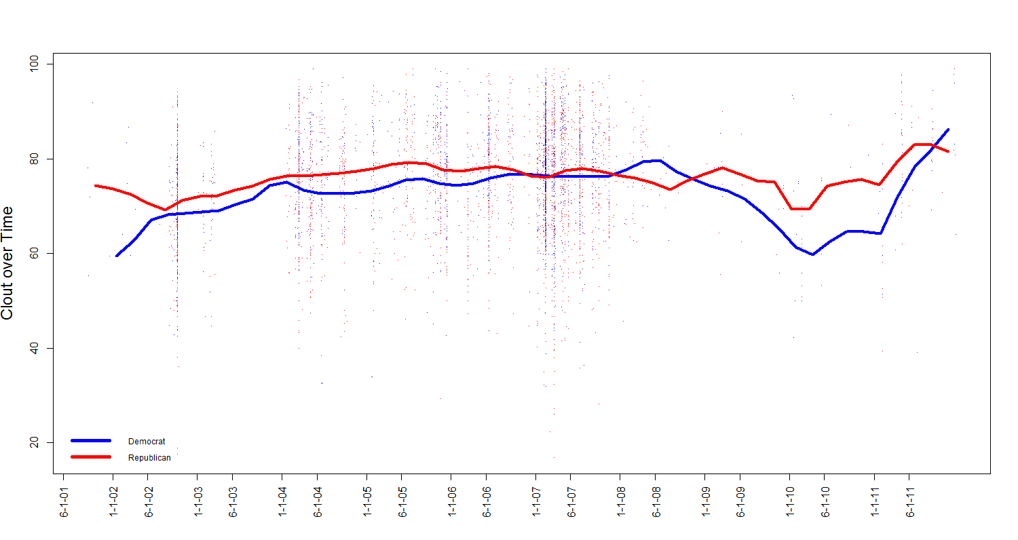
Linguistic Changes in Foreign Policy Discourse
Kayla N. Jordan
University of Texas at Austin
Introduction
In an ever-changing world of foreign relations, understanding how world leaders process and interpret events will be useful in predicting potential official reactions. The focus of the current study is on the U.S. Congress, who, despite the power they can exert on world politics, is an understudied population. Language, more specifically word frequency in congressional speeches, is one way to measure how people approach situations. Therefore, we examined speeches on foreign policy issues to U.S. relations with Iraq to elucidate Congressional thinking.
Purpose
The purpose of the current study is to explore how congressional language changed over the course of the Iraq War as well as the possible role of party affiliation in these changes.
Analytic Thinking
High analytic thinking is associated with a more formal and logical thinking style as well as a more deliberative approach to decision making.
Analytic thinking is indicated by a greater use of articles and prepositions with fewer pronouns, auxiliary verbs, adverbs, conjunctions, and negations.
Overall, congressional speeches are higher in analytic thinking than average texts.
Analytic thinking seems to be more related to changes in political power rather than events in the course of the Iraq War.
Democrats become more analytic during the time they control both chambers of Congress.
Republicans relative stable over time.
Method
Data: Speeches from the U.S. House of Representatives and Senate
Inclusion: Speeches pertaining to U.S. relations with Iraq from 2001-2011.
Sample: Senate-898 speeches from 130 unique senators. Word count, M = 1540.10 (SD = 1151.35). Democrats made 498 of the speeches and Republicans delivered 400 of the speeches. Time in office, M = 17.97 years (SD = 11.08).
House of Representatives-3229 speeches by 535 congressmen and women. Word count, M = 802.46 (SD = 997.50). Democrats gave 1966 speeches, and Republicans gave 1263. Time in office, M = 10.53 years (SD = 8.29).
Analysis
Data Processing: LIWC2015 was used to calculate analytical thinking, clout, emotional tone, and authenticity for each speech. For each dimension, the average score is 50 with a approximate standard deviation of 20.
Analysis: Nonparametric regression was used to estimate changes in language over time.
Emotional Tone
Emotional tone is the difference between positive emotion words and negative emotion words. Higher scores indicate more positivity whereas lower score indicate more negativity.
Overall, there is a trend that the language used becomes more positive over time.
Democrats generally became more positive over time specifically near the in of the conflict. Democrats were more positive than the Republicans around the time a timeline for withdrawal was set.
Republicans were much more variable. Republicans were more positive than Democrats from 2003-2005.
n=55
n=206
Events in the Iraq War and Changes in Congressional Power
Year | Events | Senate | House
2001 | 9/11 terrorist attacks | Split | Republicans
2002 |  | Democrats | Republicans
2003 | U.S. invasion of Iraq (March) President Bush announces end of major combat operations (May) Bombing of UN headquarters in Baghdad by insurgents (August) | Republicans | Republicans
2004 | Support for war wanes | Republicans | Republicans
2005 | New Iraqi government elected | Republicans | Republicans
2006 |  | Republicans | Republicans
2007 | Authorization of troop increase (January) Congress approves funding increases (May) | Democrats | Democrats
2008 |  | Democrats | Democrats
2009 | Timeline for withdrawal set | Democrats | Democrats
2010 |  | Democrats | Democrats
2011 | U.S. officially withdraws from Iraq (December) | Democrats | Republicans
Authenticity
Authenticity is a measure of how personally and honestly a person is speaking.
Authentic language uses more insight (i.e. explain, decide) and differentiation (i.e. or, rather) words as well as more relativity (i.e. close, stay) words and fewer discrepancy words (i.e. could, expect) and singular third person pronouns (i.e. he, she).
Authenticity remained relative stable over the time frame; however, it is interesting to note that congressional speeches are less authentic than average texts.
Clout
Clout is associated with confidence and is often seen in leaders.
Clout is indicated by greater use of we-words, you-words, and social words and fewer I-words, swear words, negations, and differentiations.
These congressional speeches are higher in clout language than average texts.
Few changes in clout occurred during the time period.
Democrats’ language started becoming less confident around the time President Obama announces a move away from combat operations; clout began to increase again around the midterm elections.
Republicans’ language became slightly more confident around President Obama’s announcement in 2009.
Acknowledgements: I would like to thank Dr. Erin Buchanan at Missouri State University for her help with this project.
Contact: Kayla Jordan (kaylajordan91@gmail.com)

